Slide 1
AIRLINE PRICE PREDICTION
Predictive Analysis_CSE3047
Faculty: Prof.N.Nalini

Slide 2
TABLE OF CONTENT
INTRODUCTION
DATASET
PREPROCESSING
HANDLING CATEGORICAL DATA
DATA VISUALIZATION
MODEL
CONCLUSION

Slide 3
INTRODUCTION
Nowadays, airline ticket prices can vary dynamically and significantly for the same flight, even for nearby seats within the same cabin. Customers are seeking to get the lowest price while airlines are trying to keep their overall revenue as high as possible and maximize their profit. From the customer point of view, determining the minimum price or the best time to buy a ticket is the key issue. The ticket price may be affected by several factors thus may change continuously. To address this, various studies were conducted to support the customer in determining an optimal ticket purchase time and ticket price prediction.

Slide 4
DATASET
No.of.Rows: 10683 No.of. Columns: 10
Attributes:
Airline Duration
Date_of_Journey Total_Stops
Source Additional info
Destination Price
Dep_time
Arrival_time
Source: https://www.kaggle.com/code/anshigupta01/flight-price-prediction/data

Slide 5
Data Preprocessing

Slide 6
Import packages, load data
import numpy as np # linear algebra
import pandas as pd # data processing,
import matplotlib.pyplot as plt
import seaborn as sns
from sklearn.preprocessing import StandardScaler
import warnings
warnings.filterwarnings('ignore')
df = pd.read_csv("C:/Users/DELL/Desktop/fall sem22-23/PA 3047/project/PA PRICE_PREDICTION DATASET.csv")

Slide 7
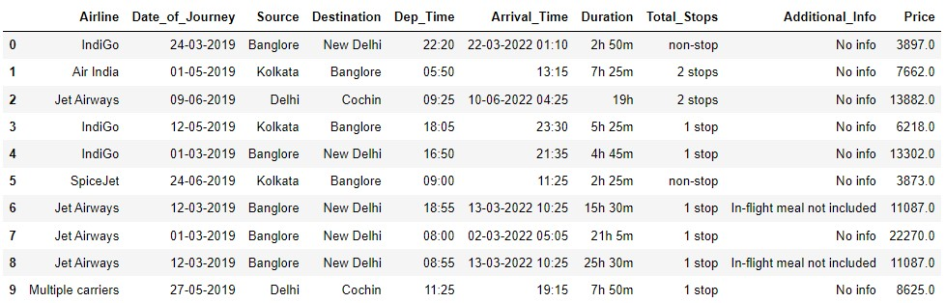
Import packages, load data
Df.head(10)

Slide 8
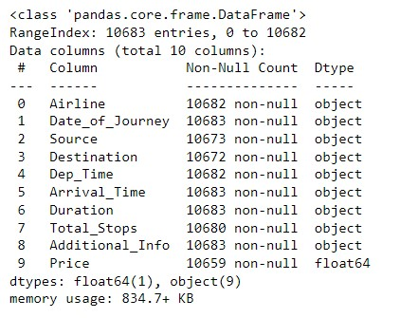
Data Preprocessing
df.info()

Slide 9
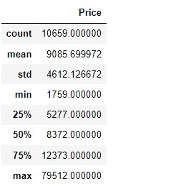
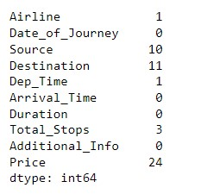
Data Preprocessing
df.describe() df.isna().sum()

Slide 10
Handling Missing Values
print("Number of Categories in: ")
for ColName in df[['Source','Destination']]:
print("{} = {}".format(ColName, len(df[ColName].unique())))
#replace null values with mode
df['Source'] = df['Source'].fillna(df['Source'].mode()[0])
df['Destination'] = df['Destination'].fillna(df['Destination'].mode()[0])
#drop NULL from Airlines, Dep_time,Total_Stops
df = df.dropna(subset=['Airline','Dep_Time','Total_Stops'])
#replace NULL with mean(PRICE)
df=df.fillna(df.mean())

Slide 11
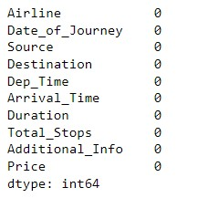
Handling Missing Values
df.isna().sum()
Source, Destination: Object datatype
no.of.nulls: 10,11
replaced with respective mode
Total_Stops: Integer datatype
no.of.nulls: 3 <<< 10638 val
dropped the row
Airline,Dep_time: Object datatype
no.of.nulls: 1,1 <<< 10638 val
dropped the row
Price: Float datatype
no.of.nulls: 24
replaced with mean

Slide 12
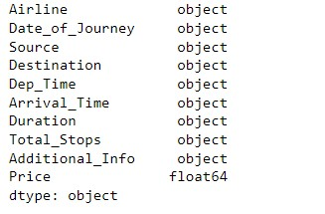
Data Preprocessing
df.dtypes #datatypes
Datatypes of Date_of_journey, Arrival_Time and
Dep_Time is object. Convert it into date and time format.

Slide 13
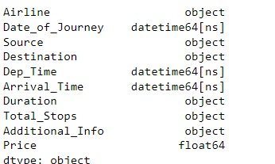
Data Preprocessing
def change_into_datetime(col):
df[col]=pd.to_datetime(df[col])
for i in ['Date_of_Journey','Dep_Time', 'Arrival_Time']:
change_into_datetime(i)
df.dtypes

Slide 14
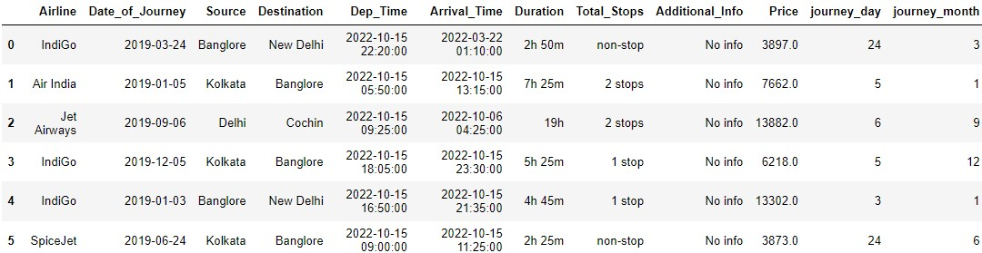
Data Preprocessing
df['journey_day']=df['Date_of_Journey'].dt.day #method to extract only day of that date
df['journey_month']=df['Date_of_Journey'].dt.month #extract only month of that date
df.head(6)
df.drop('Date_of_Journey', axis=1, inplace=True)

Slide 15
Data Preprocessing
#From Arrival_time and Dept_time features,we extract hour and minutes and stored in new columns and drop these columns
# extracting hour
def extract_hour(data,col):
data[col+'_hour']=data[col].dt.hour
# extracting minute
def extract_min(data,col):
data[col+'_min']=data[col].dt.minute
#drop previous col
def drop_col(data,col):
data.drop(col,axis=1,inplace=True)

Slide 16
Data Preprocessing
#extracting hour from dep_time
extract_hour(df,'Dep_Time')
#extracting minutes from dep_time
extract_min(df,'Dep_Time')
#drop the column dep_time
drop_col(df,'Dep_Time')
#extracting hour form arr_time
extract_hour(df,'Arrival_Time')
#extracting min from arr_time
extract_min(df,'Arrival_Time')
#drop the column arr_time
drop_col(df,'Arrival_Time')

Slide 17
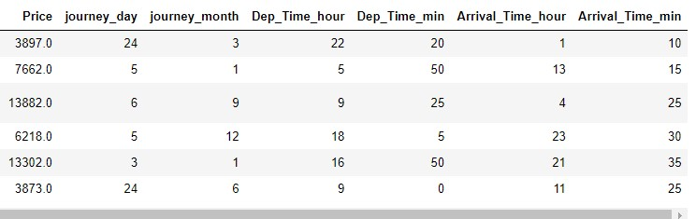
Data Preprocessing
df.head(6)

Slide 18
Data Preprocessing
Apply pre-processing on duration column. Separate Duration hours and minute from duration
duration=list(df['Duration'])
for i in range(len(duration)):
if len(duration[i].split(' '))==2:
pass
else:
if 'h' in duration[i]: # Check if duration contains only hour
duration[i]=duration[i] + ' 0m' # Adds 0 minute
else:
duration[i]='0h '+ duration[i]
df['Duration']=duration

Slide 19
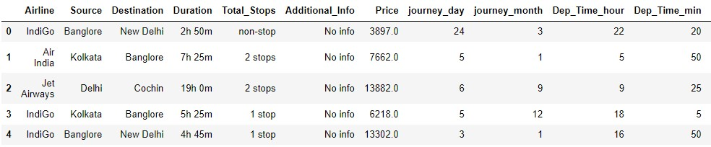
Data Preprocessing
df.head()

Slide 20
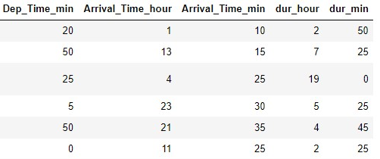
Data Preprocessing
def hour(x):
return x.split(' ')[0][0:-1]
def minutes(x):
return x.split(' ')[1][0:-1]
df['dur_hour']=df['Duration'].apply(hour)
df['dur_min']=df['Duration'].apply(minutes)
df.head(6)
drop_col(df,'Duration')

Slide 21
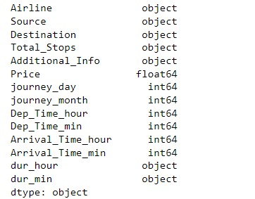
Data Preprocessing
df.dtypes
Dep_time, Arrival_time are seperated into hours and mins. Similarly Date_of_Journey is seperated as journey_day, journey_month respectively, with proper integer datatype.
#Convert dur_hour, dur_min datatype from object to integer.

Slide 22
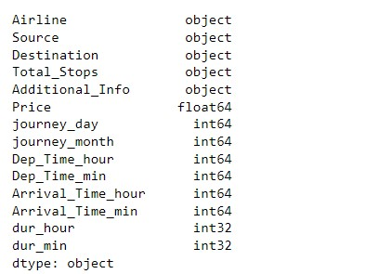
Data Preprocessing
#converting datatype of dur_hour, dur_min (object) to integer
df['dur_hour'] = df['dur_hour'].astype(int)
df['dur_min'] = df['dur_min'].astype(int)
df.dtypes

Slide 23
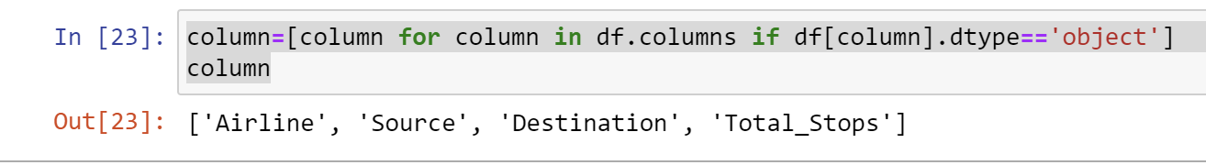
Data Preprocessing
HANDLING CATEGORICAL DATA:
In this Dataset, We are using the two Different types of Encoding to change Categorical Data into Numerical Data.
Nominal data -- Data that are not in any order -->one hot encoding
ordinal data -- Data are in order --> labelEncoder
column=[column for column in df.columns if df[column].dtype=='object']
column

Slide 24
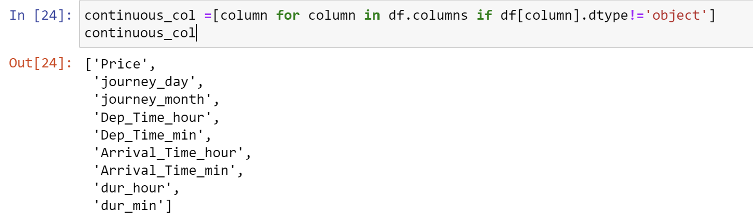
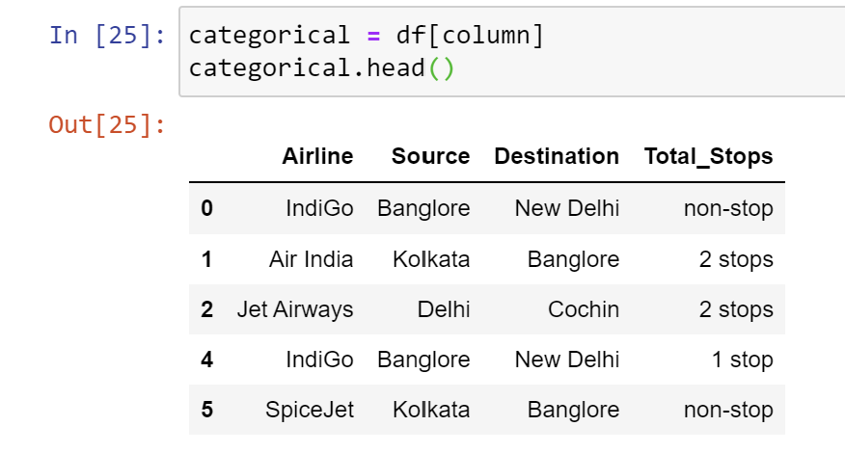
Data Preprocessing
continuous_col =[column for column in df.columns if df[column].dtype!='object']
continuous_col
categorical = df[column]
categorical.head()

Slide 25
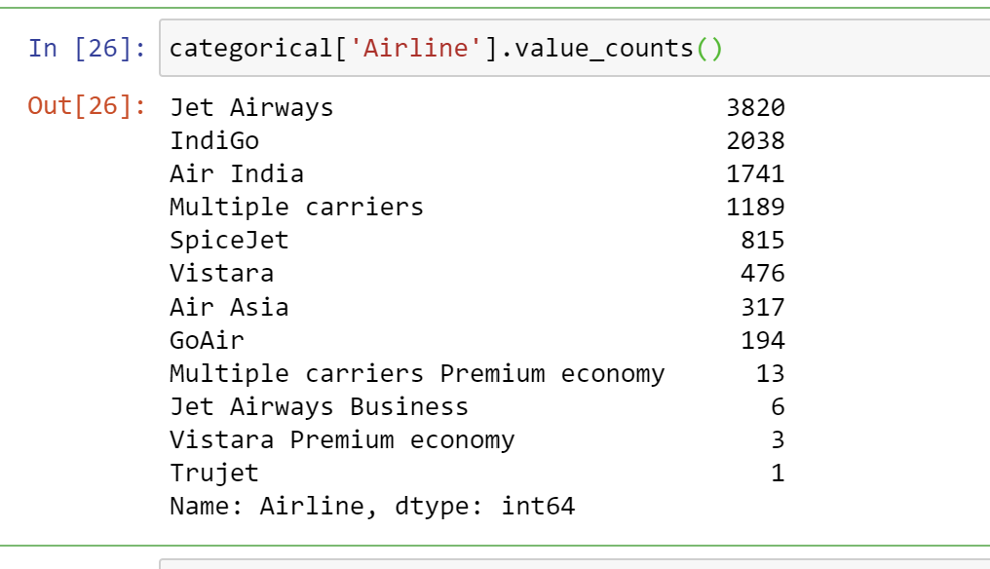
Data Preprocessing
categorical['Airline'].value_counts()

Slide 26
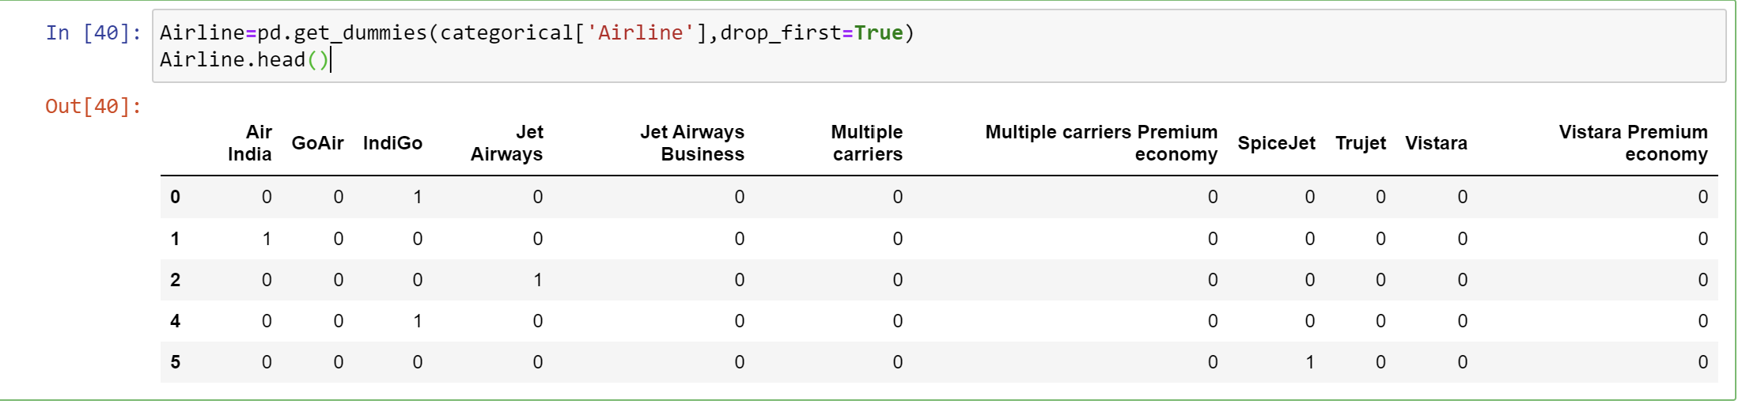
Data Preprocessing
As Airline is Nominal Categorical Data, we perform one-hot Encoding.
Airline=pd.get_dummies(categorical['Airline'],drop_first=True)
Airline.head()

Slide 27
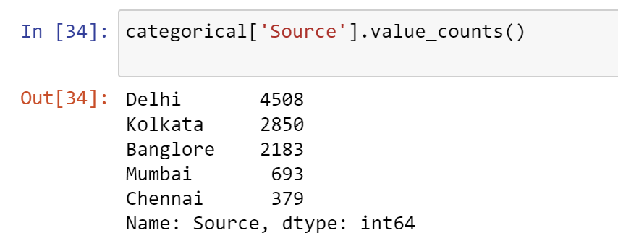
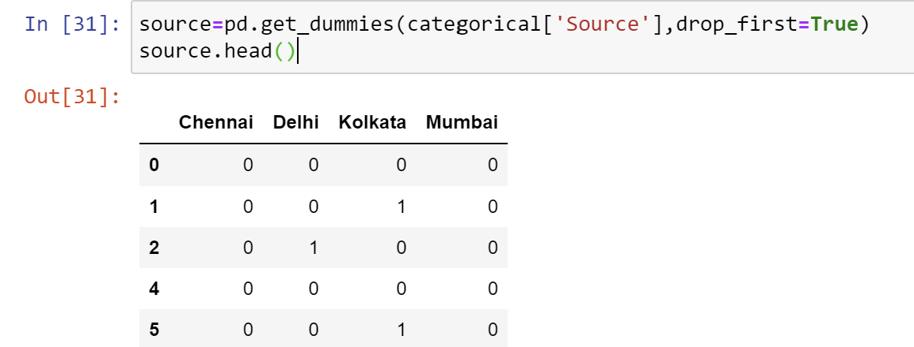
Data Preprocessing
categorical['Source'].value_counts()
Encoding Source Column:
source=pd.get_dummies(categorical['Source'],drop_first=True)
source.head()

Slide 28
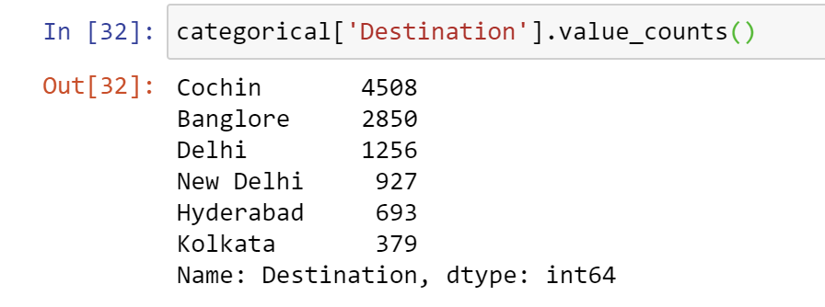
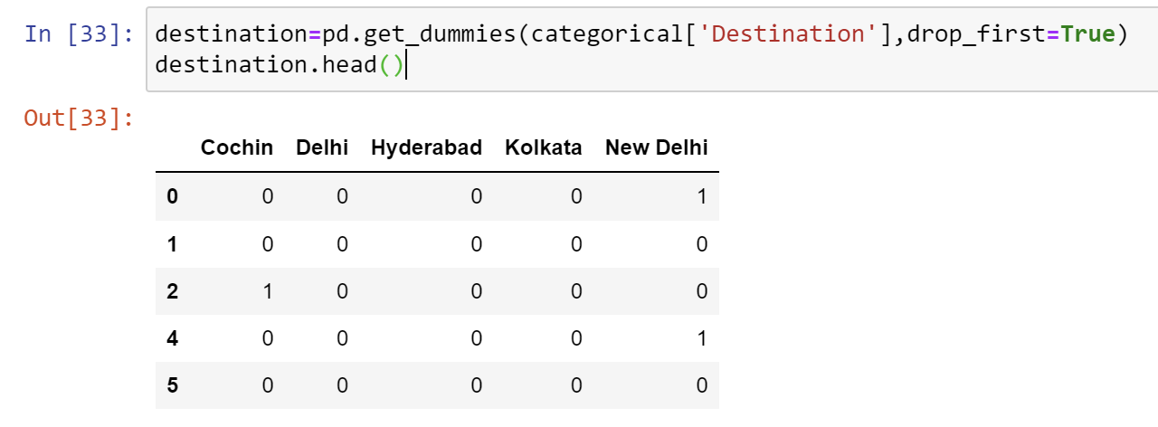
Data Preprocessing
categorical['Destination'].value_counts()
Encoding the Desination Column:
destination=pd.get_dummies(categorical['Destination'],drop_first=True)
destination.head()

Slide 29
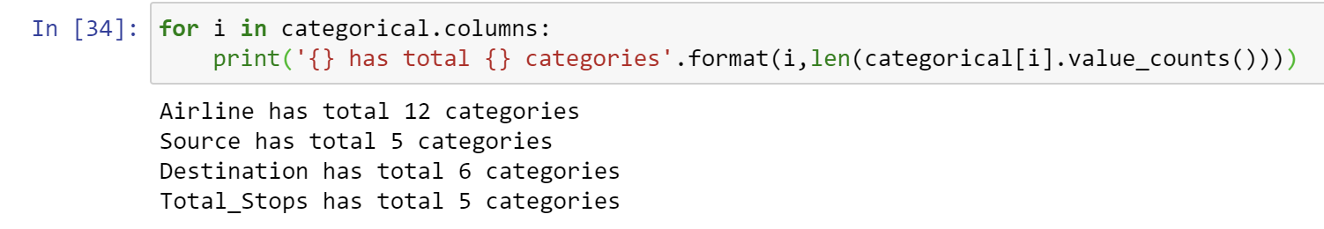
Data Preprocessing
To find Number of Categories in Each Categorial Column
for i in categorical.columns:
print('{} has total {} categories'.format(i,len(categorical[i].value_counts())))

Slide 30
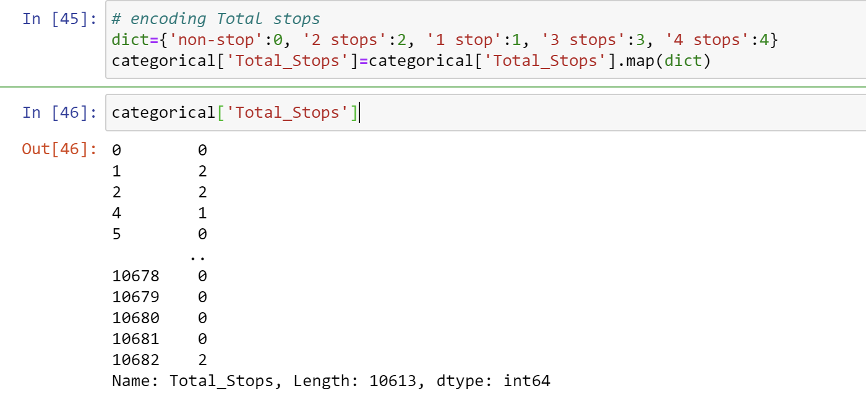
Data Preprocessing
Encoding the Total Stops:
dict={'non-stop':0, '2 stops':2, '1 stop':1, '3 stops':3, '4 stops':4}
categorical['Total_Stops']=categorical['Total_Stops'].map(dict)
categorical['Total_Stops’]

Slide 31
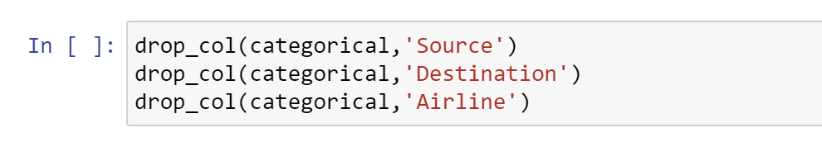
Data Preprocessing
Dropping the Categorical Column:
drop_col(categorical,'Source')
drop_col(categorical,'Destination')
drop_col(categorical,'Airline')

Slide 32
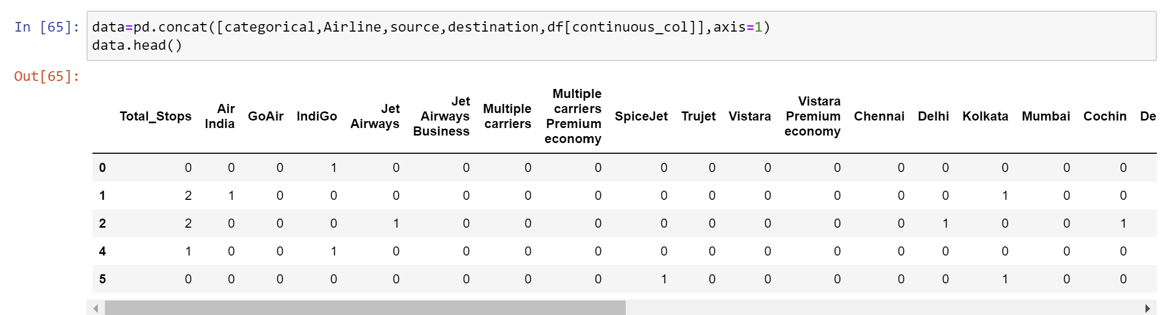
Data Preprocessing
Concatenating All Categorical Values:
data=pd.concat([categorical,Airline,source,destination,df[continuous_col]],axis=1)
data.head()

Slide 33
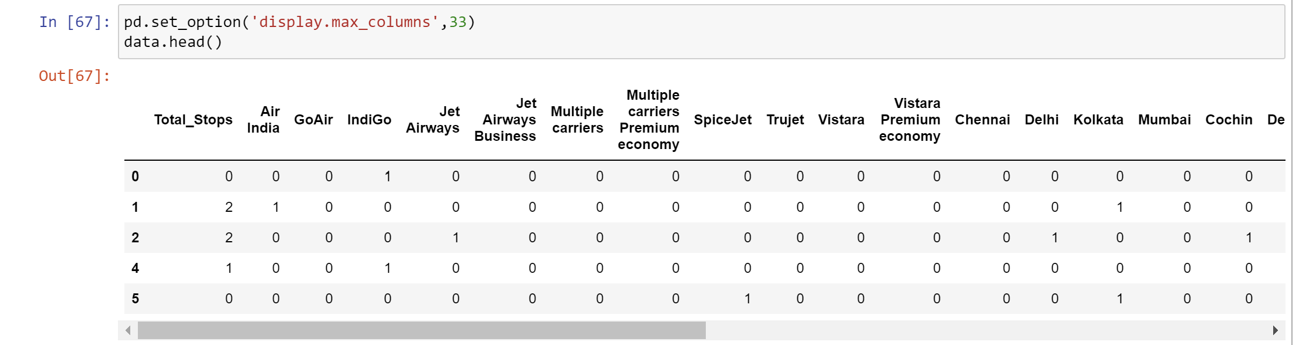
Data Preprocessing
pd.set_option('display.max_columns',33)
data.head()

Slide 34
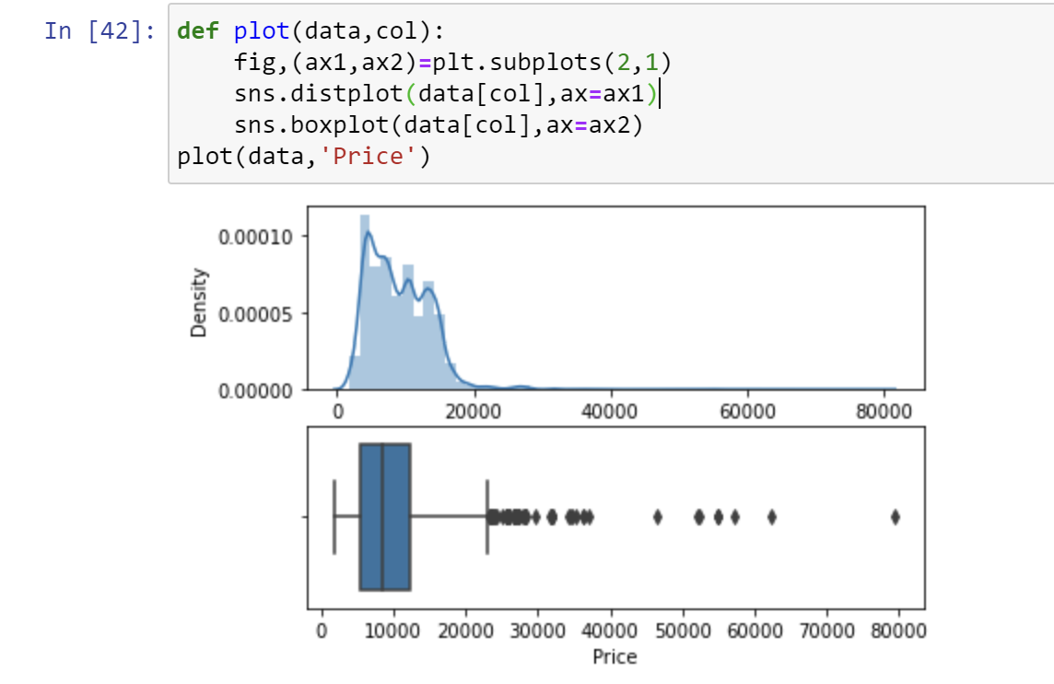
Data Preprocessing
CHECK FOR OUTLIERS:
def plot(data,col):
fig,(ax1,ax2)=plt.subplots(2,1)
sns.distplot(data[col],ax=ax1)
sns.boxplot(data[col],ax=ax2)
plot(data,'Price')
There is some outliers in price features, so we replace it with median.

Slide 35
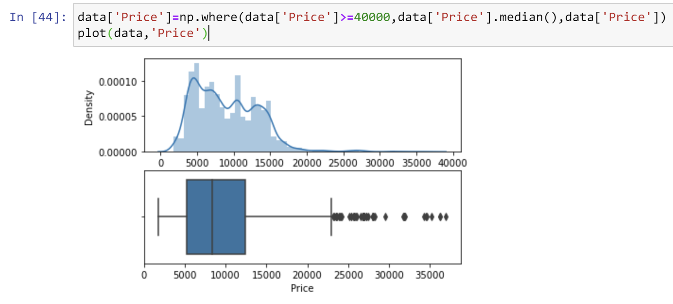
Data Preprocessing
HANDLING THE OUTLIERS:
data['Price']=np.where(data['Price']>=40000,data['Price'].median(),data['Price'])
plot(data,'Price')

Slide 36
Data Visualization

Slide 37
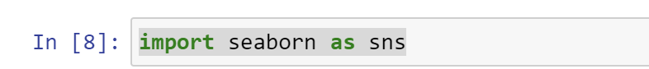
Data Visualization
Data visualization is the graphical representation of information and data. By using visual elements like charts, graphs, and maps, data visualization tools provide an accessible way to see and understand trends, outliers, and patterns in data.
Importing the Packages:
import seaborn as sns

Slide 38
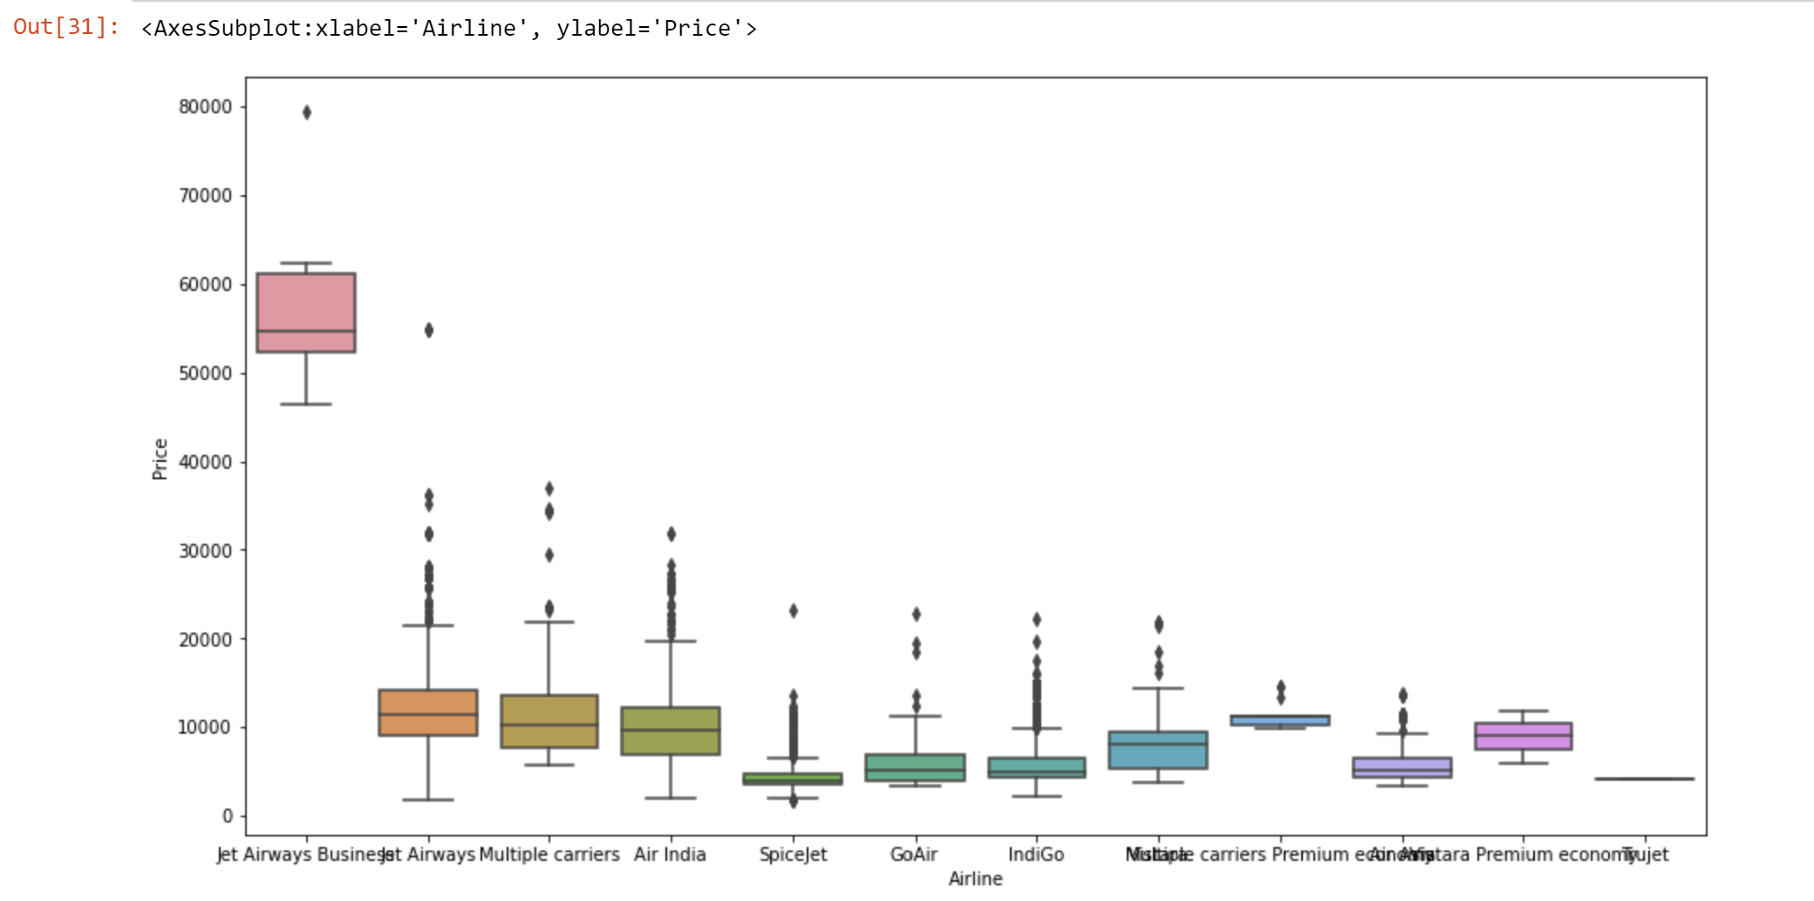
Data Visualization
Visualization of Airline Data with Price:
plt.figure(figsize=(15,8))
sns.boxplot(x='Airline',y='Price',data=df.sort_values('Price',ascending=False))
Indigo
Air India
Jet Airways
SpiceJet
Multiple Carriers
Go Air
Vistara
Air Asia
Vistara Premium Economy
Jet Airways Business
Multiple Carriers Premium Economy
Trujet

Slide 39
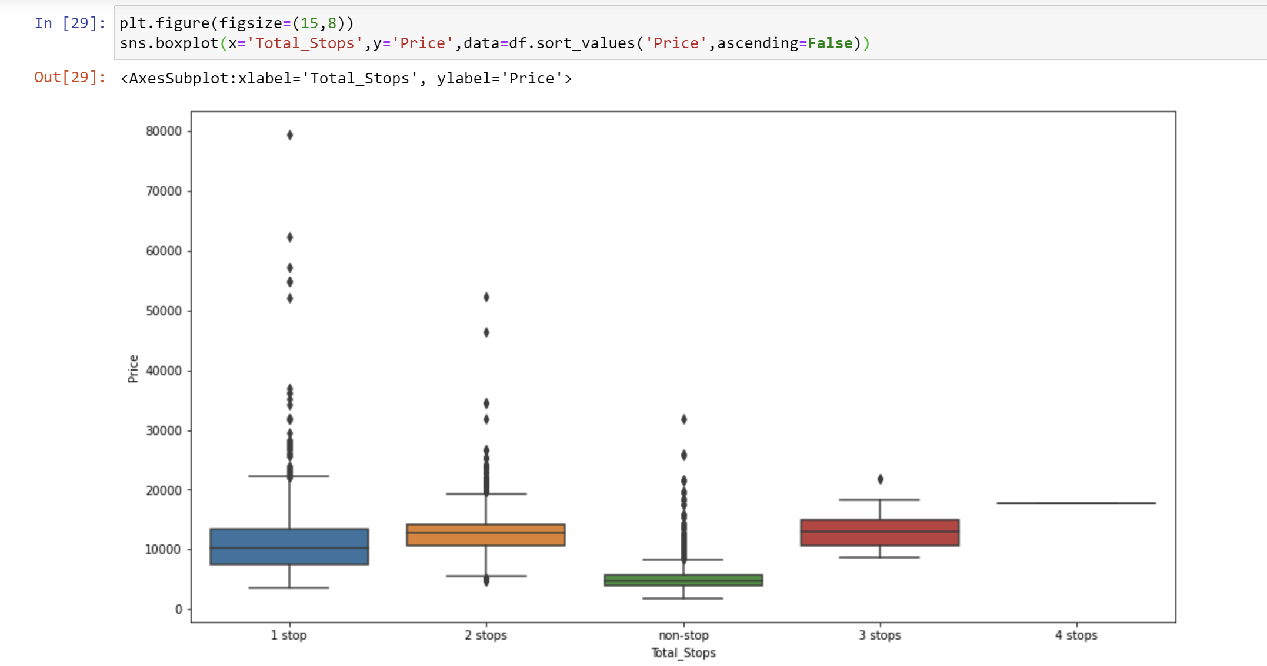
Data Visualization
Visualization of Total Stops Data with Price:
plt.figure(figsize=(15,8))
sns.boxplot(x='Total_Stops',y='Price',data=df.sort_values('Price',ascending=False))

Slide 40
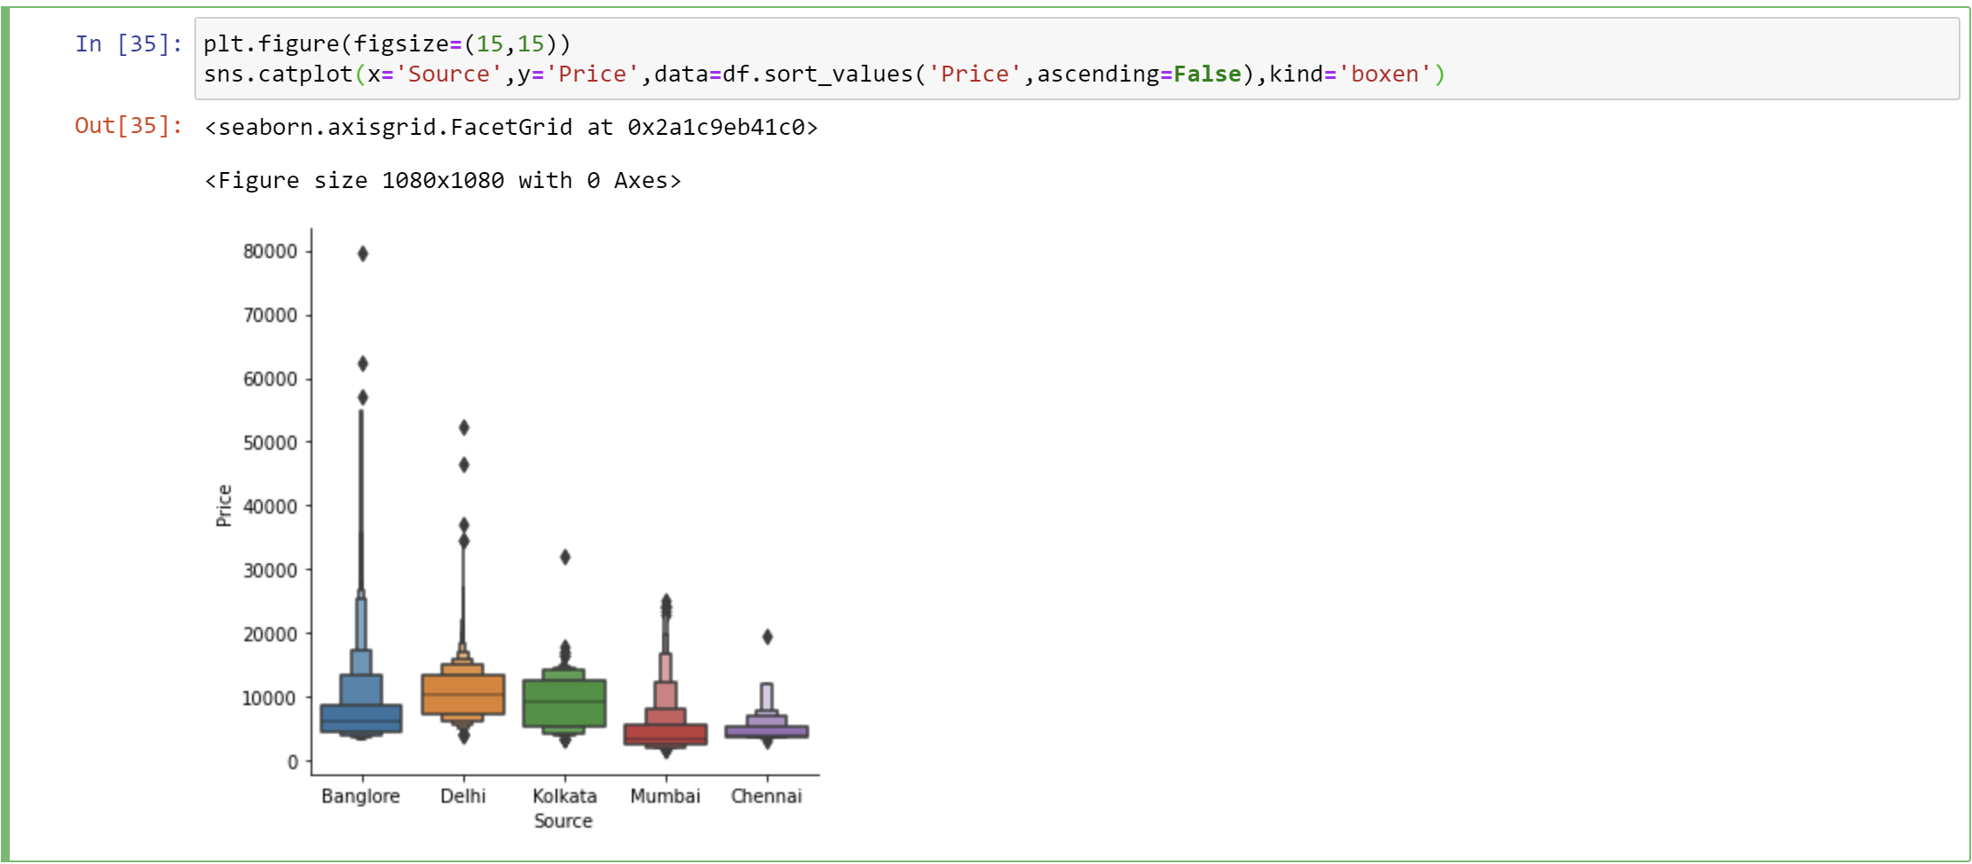
Data Visualization
Visualization of Source Data with Price:
plt.figure(figsize=(15,15))
sns.catplot(x='Source',y='Price',data=df.sort_values('Price',ascending=False),kind='boxen')

Slide 41
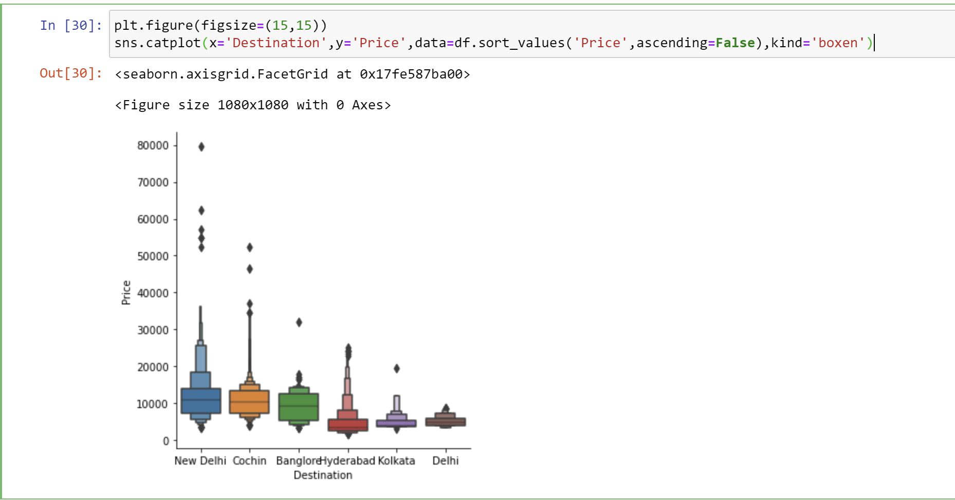
Data Visualization
Visualization of Destination Data with Price:
plt.figure(figsize=(15,15))
sns.catplot(x='Destination',y='Price',data=df.sort_values('Price',ascending=False),kind='boxen')

Slide 42
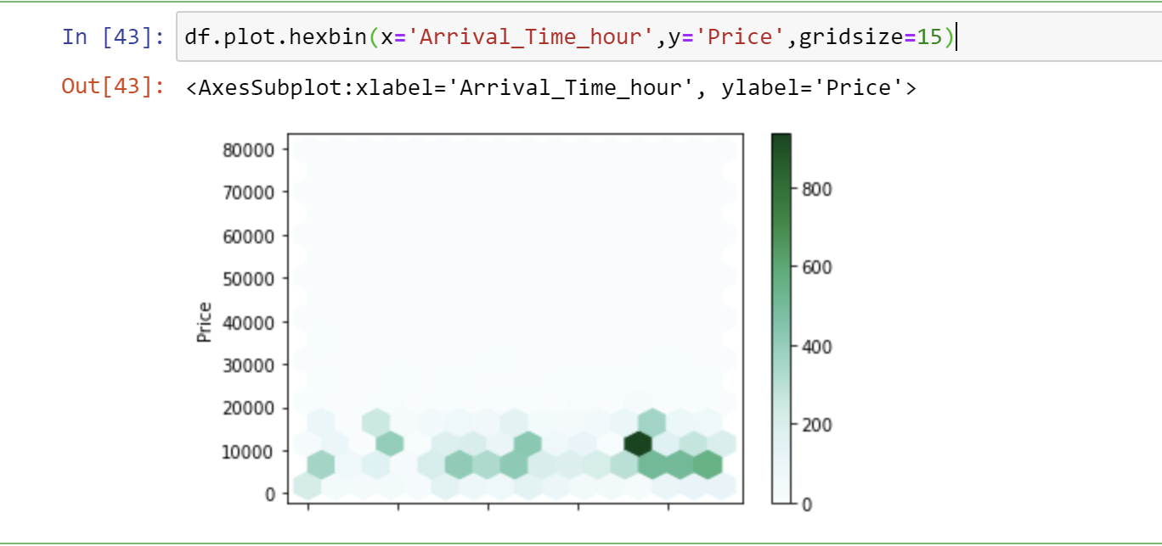
Data Visualization
Visualization of Arrival Time Hour with Price:
df.plot.hexbin(x='Arrival_Time_hour',y='Price',gridsize=15)

Slide 43
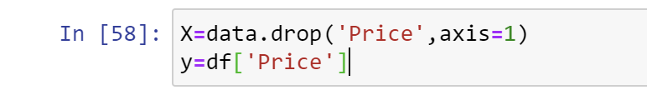
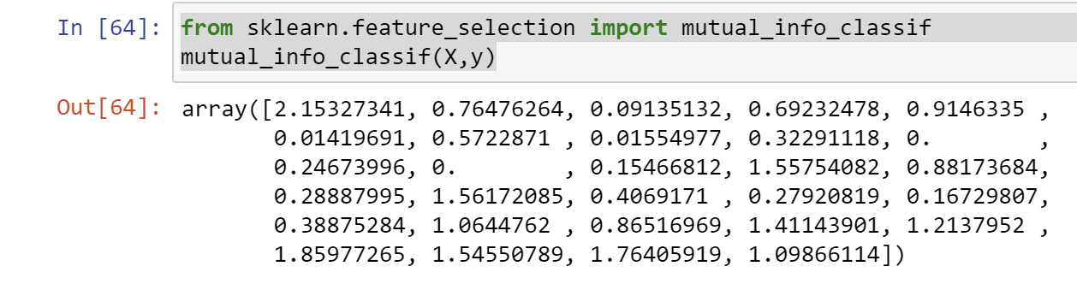
MODELS
Assigning the X and Y value:
X=data.drop('Price',axis=1)
y=df['Price’]
Feature Selection:
from sklearn.feature_selection import mutual_info_classif
mutual_info_classif(X,y)

Slide 44
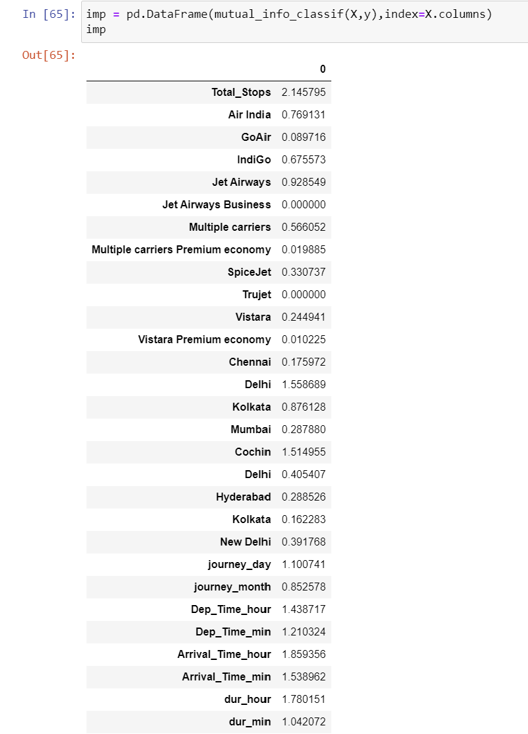
MODELS
imp = pd.DataFrame(mutual_info_classif(X,y),index=X.columns)
Imp

Slide 45
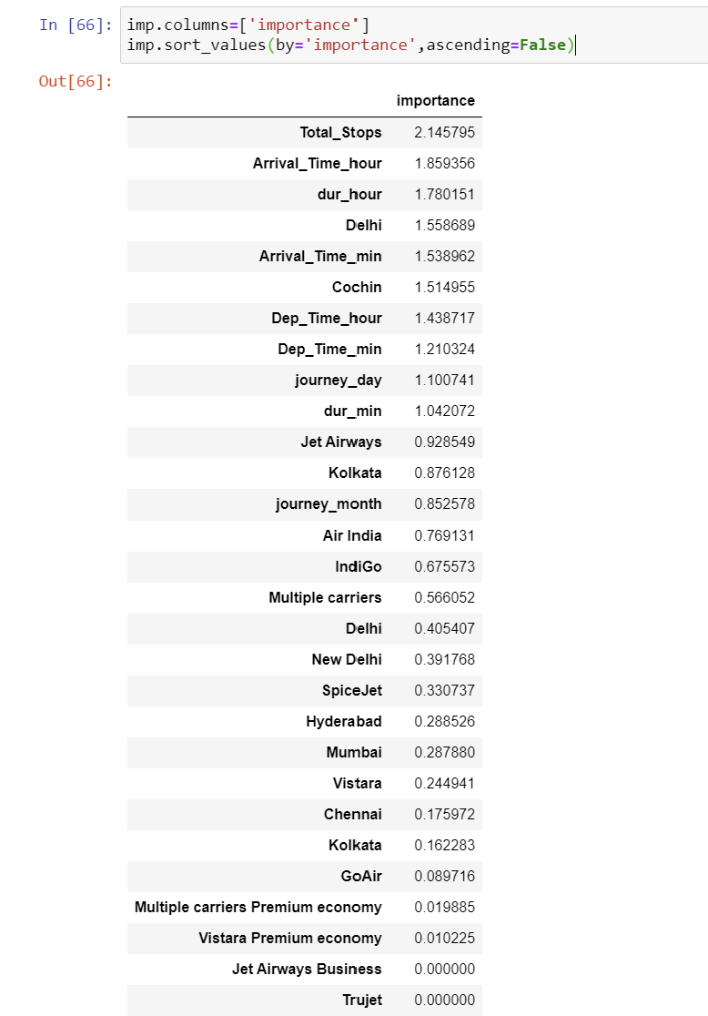
MODELS
imp.columns=['importance']
imp.sort_values(by='importance',ascending=False)

Slide 46
MODELS
Splitting the Dataset:
from sklearn.model_selection import train_test_split
X_train,X_test,y_train,y_test = train_test_split(X,y,test_size=0.20,random_state=123)

Slide 47
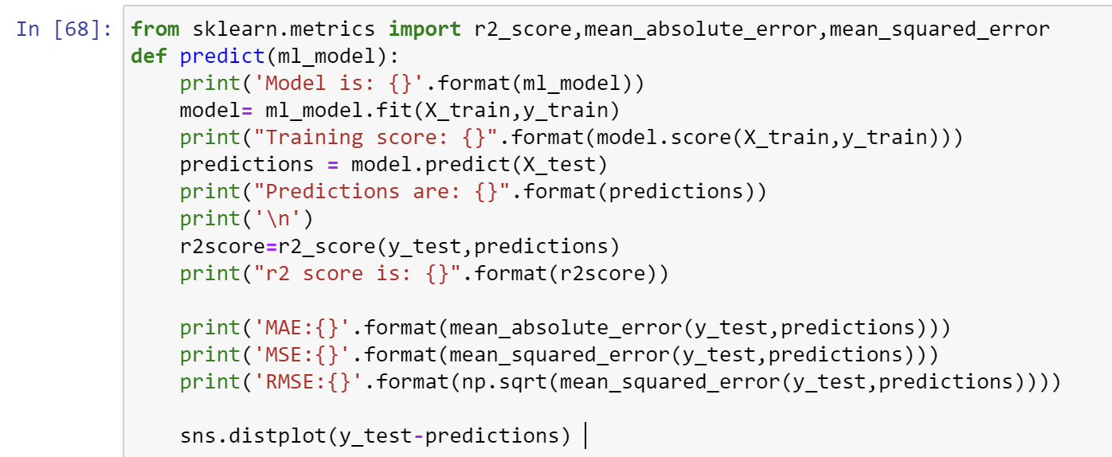
MODELS
Importing the R-square, Mean absolute and Mean Squared Error:
from sklearn.metrics import r2_score,mean_absolute_error,mean_squared_error
def predict(ml_model):
print('Model is: {}'.format(ml_model))
model= ml_model.fit(X_train,y_train)
print("Training score: {}".format(model.score(X_train,y_train)))
predictions = model.predict(X_test)
print("Predictions are: {}".format(predictions))
print('\n')
r2score=r2_score(y_test,predictions)
print("r2 score is: {}".format(r2score))
print('MAE:{}'.format(mean_absolute_error(y_test,predictions)))
print('MSE:{}'.format(mean_squared_error(y_test,predictions)))
print('RMSE:{}'.format(np.sqrt(mean_squared_error(y_test,predictions))))
sns.distplot(y_test-predictions)

Slide 48
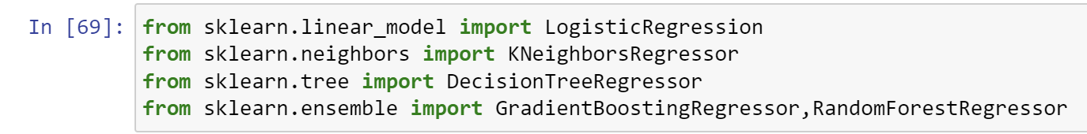
MODELS
Importing the Models:
from sklearn.linear_model import LogisticRegression
from sklearn.neighbors import KNeighborsRegressor
from sklearn.tree import DecisionTreeRegressor
from sklearn.ensemble import GradientBoostingRegressor,RandomForestRegressor

Slide 49
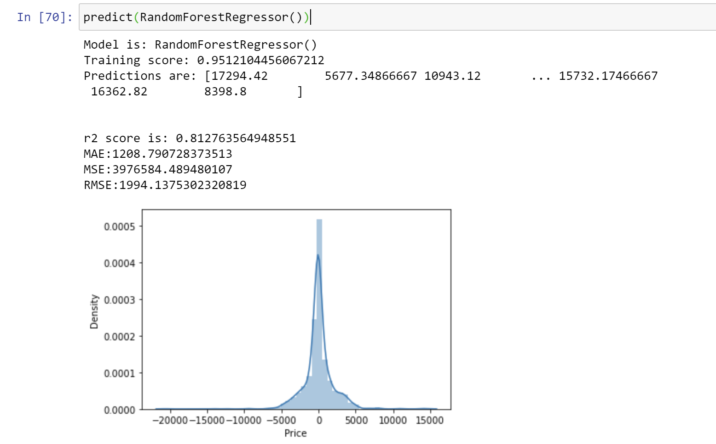
MODELS
Implementing the Model:
RandomForestRegressor
predict(RandomForestRegressor())
From the graph, we predicted 84% correctly.

Slide 50
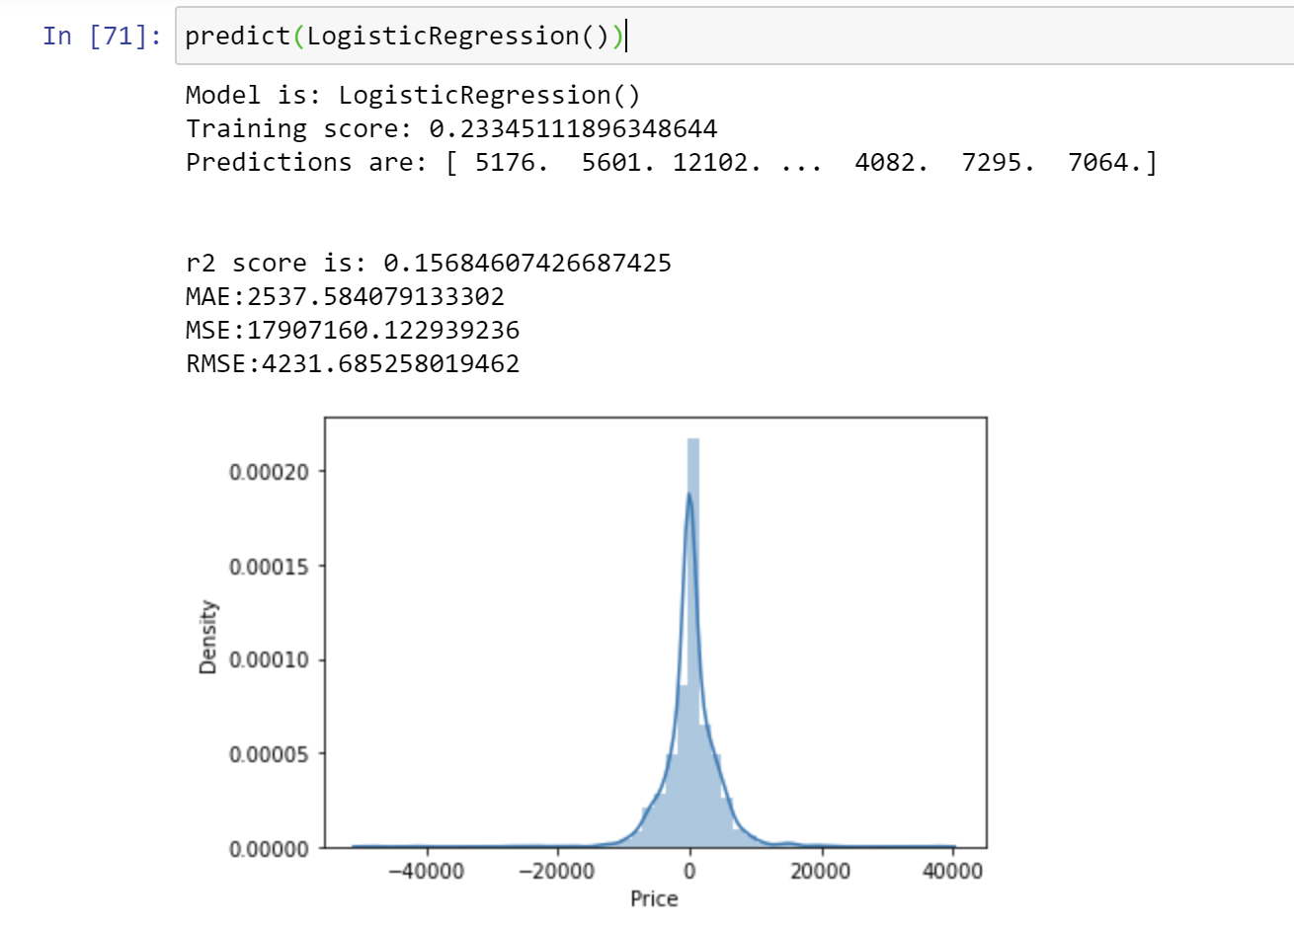
MODELS
LogisticRegression:
predict(LogisticRegression())
From the graph, we predicted 15% correctly.

Slide 51
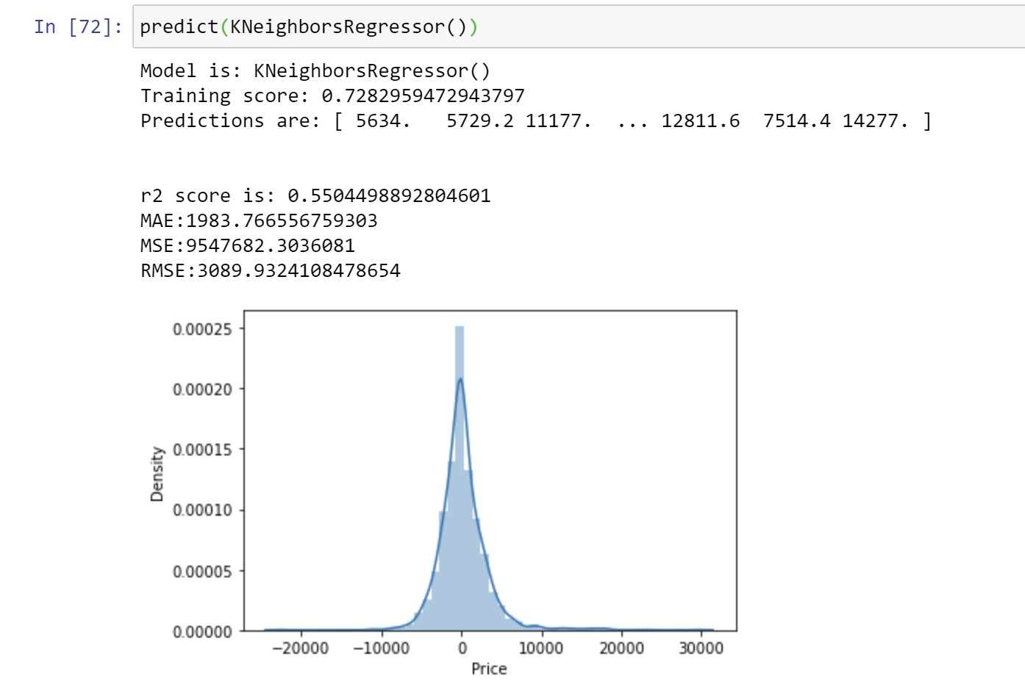
MODELS
KNeighborsRegressor:
predict(KNeighborsRegressor())
From the graph, we predicted 55% correctly.

Slide 52
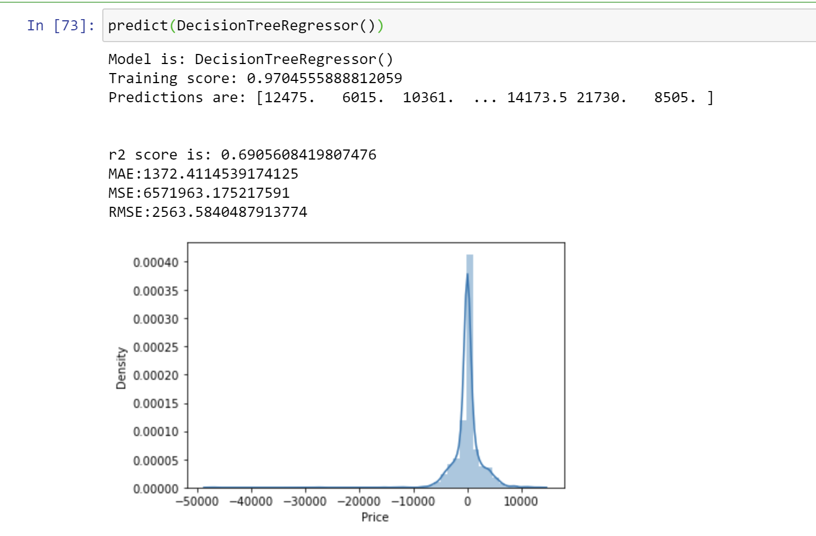
MODELS
DecisionTreeRegressor:
predict(DecisionTreeRegressor())
From the graph, we predicted 69% correctly.

Slide 53
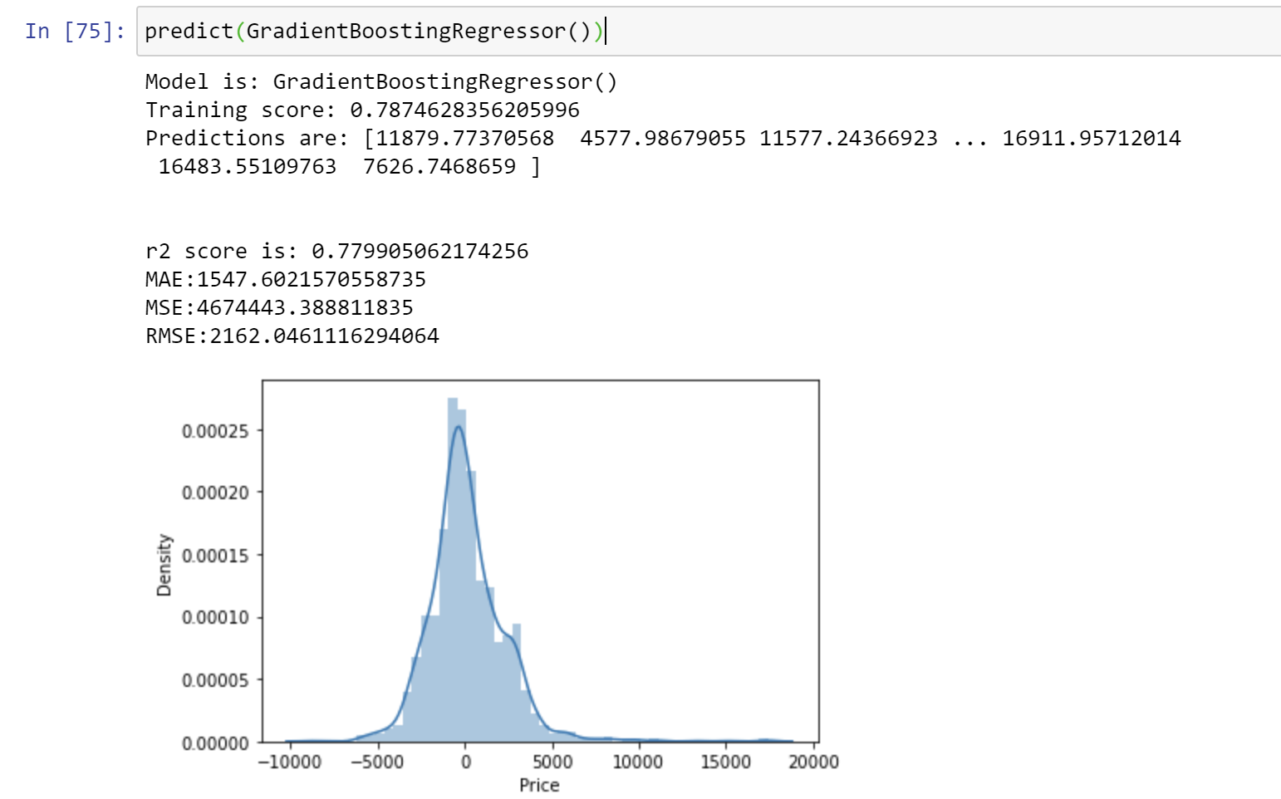
MODELS
GradientBoostingRegressor:
predict(GradientBoostingRegressor())
From the graph, we predicted 77% correctly.

Slide 54
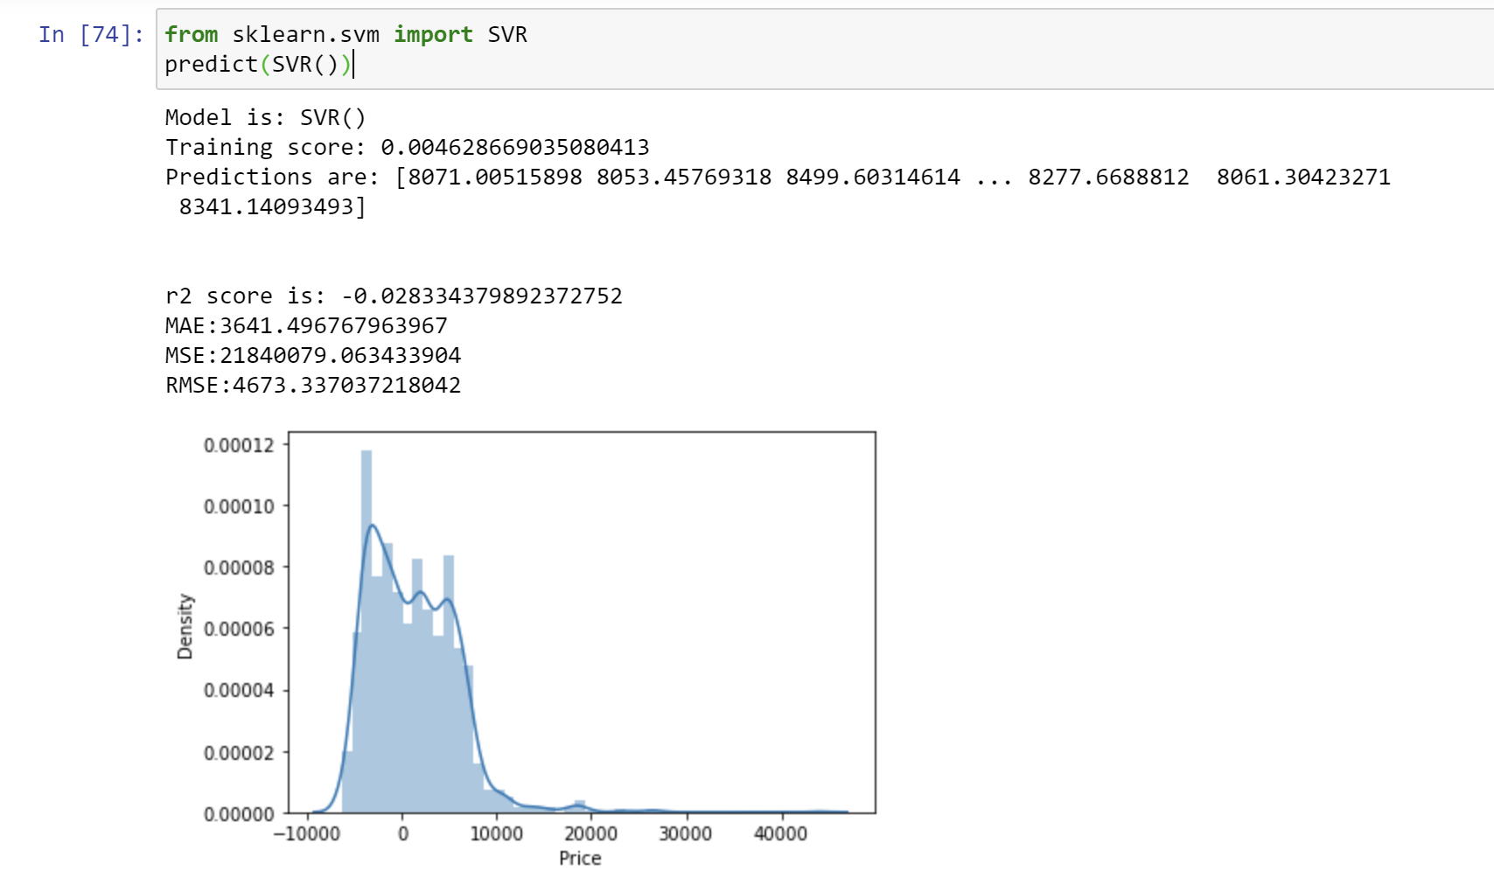
MODELS
Support Vector Regressor:
from sklearn.svm import SVR
predict(SVR())
This model is the worst model for the Airline Price Prediction.

Slide 55
Conclusion
We have taken Airline Ticket Price Prediction Dataset. In the Dataset, we have Data Processed the Dataset, Handled the Categorical Attributes for Categorical to Numerical Conversion and Data Visualization. At Last, we have implemented the Models in the Dataset and got the Result. By Seeing the Result of Each Models, we can say that Random Forest Regressor is the Best Model for the Airline Prediction Dataset.

Slide 56
THANK YOU!

